Slide 1

Data Science Process

Slide 2
Stages of a Data Science project

Slide 3
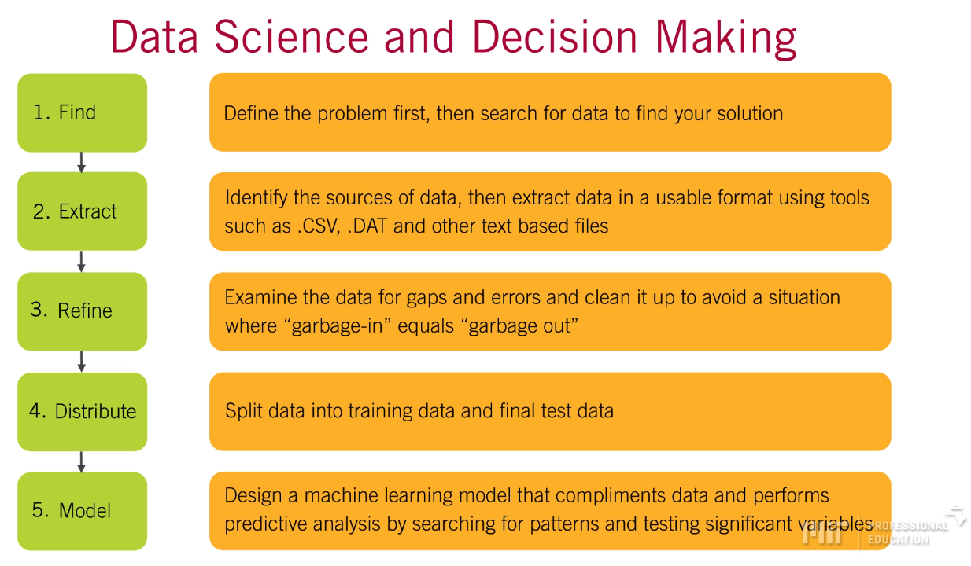
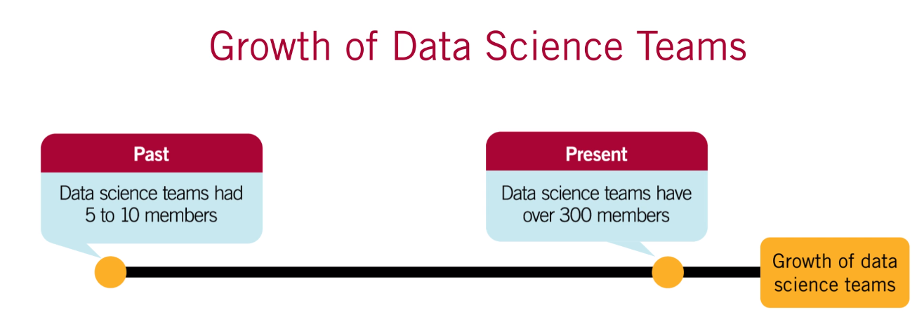
Artificial Intelligence – Building Capabilities: Data and Data Science Team

Slide 4
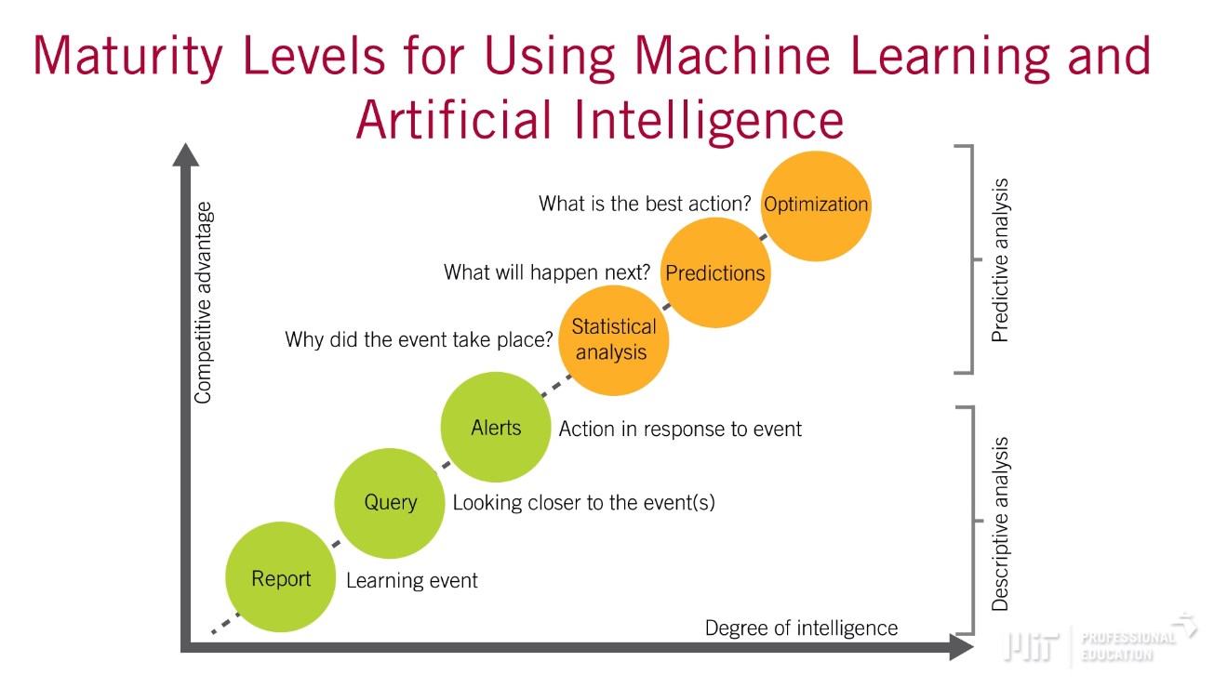
Artificial Intelligence – Building Capabilities: Data and Data Science Team

Slide 5
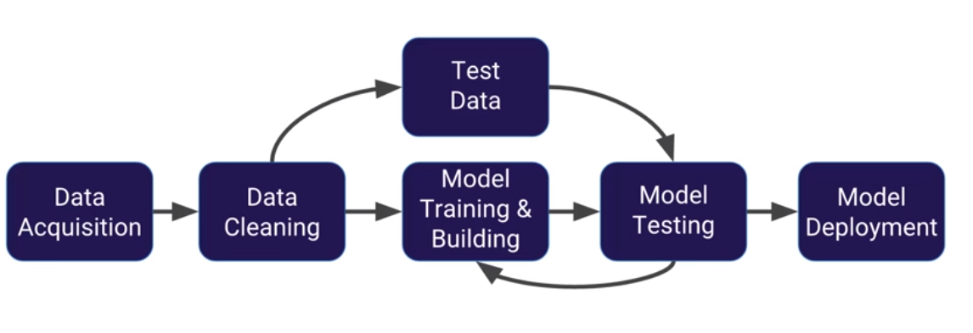
Machine Learning Workflow

Slide 6
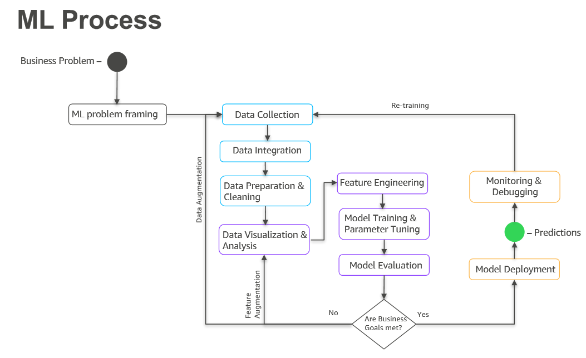

Slide 7
Roles in a Data Science Project

Slide 8
Data Engineer
Decision-Maker
Analyst
Expert Analyst
Statistician
Applied Machine Learning Engineer
Data Scientist
Analytics Manager / Data Science Leader
Qualitative Expert / Social Scientist
Researcher
Domain expert
Ethicist
Software engineer
Reliability engineer
UX designer
Data collection specialist
Data product manager

Slide 9
Setting the Expectation

Slide 10
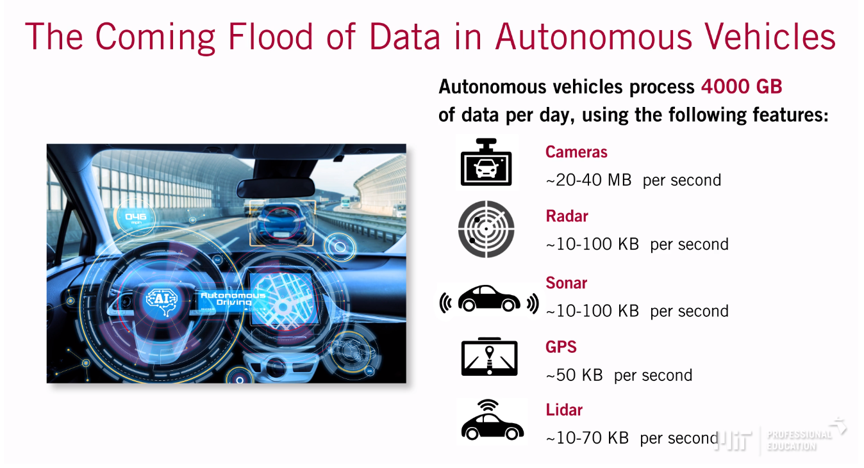
Artificial Intelligence – Managing Data with AI and Machine Learning

Slide 11
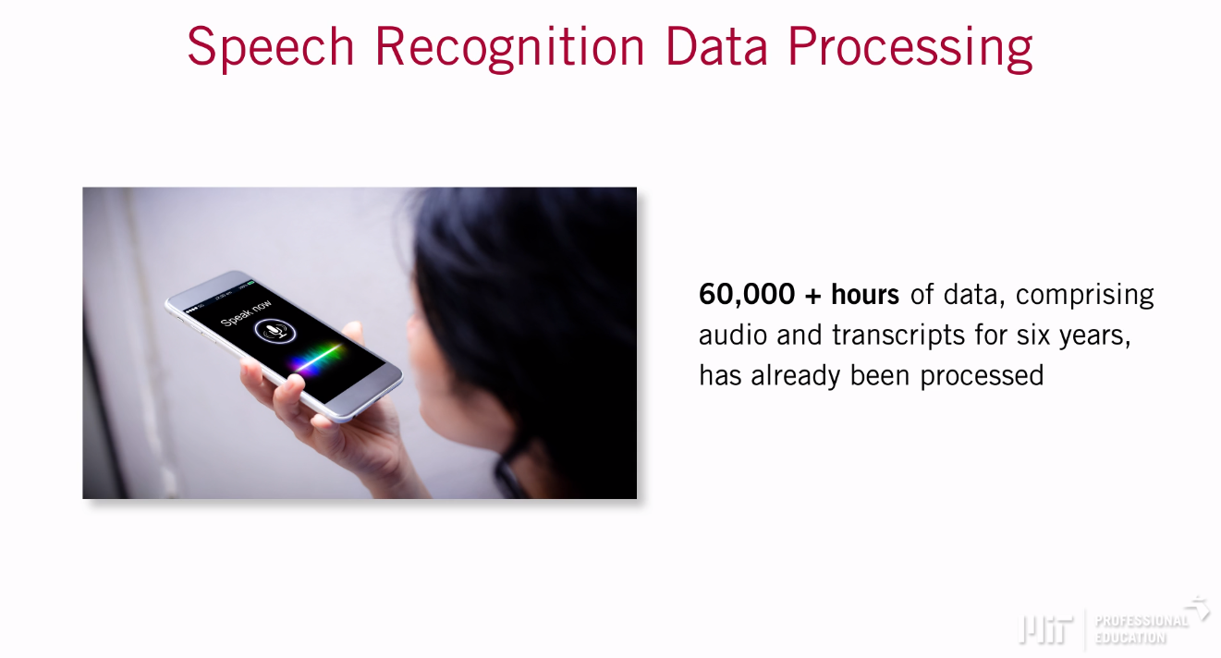
Artificial Intelligence – Managing Data with AI and Machine Learning

Slide 12
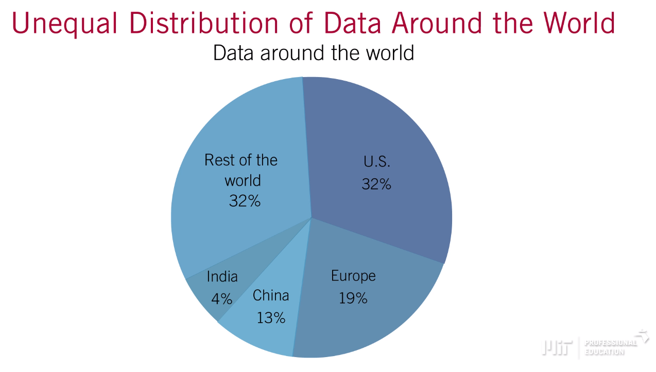
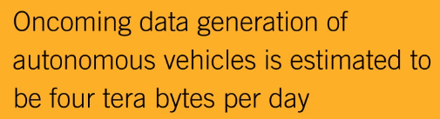
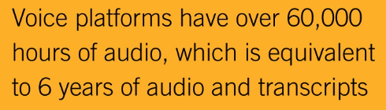
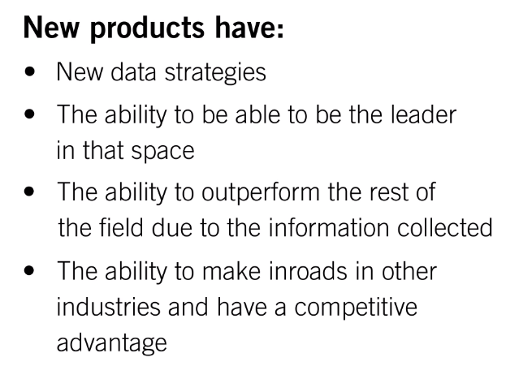
Artificial Intelligence – Building Capabilities: Data and Data Science Team
Barrier to Compete – Data

Slide 13
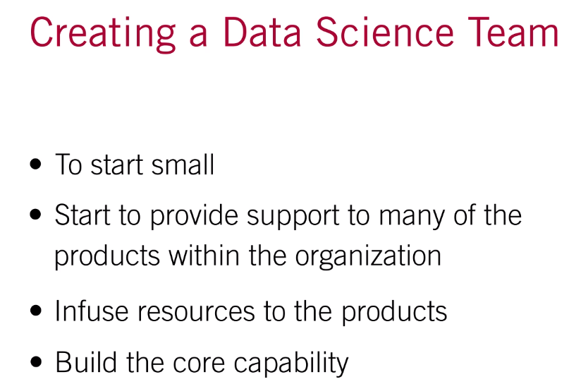
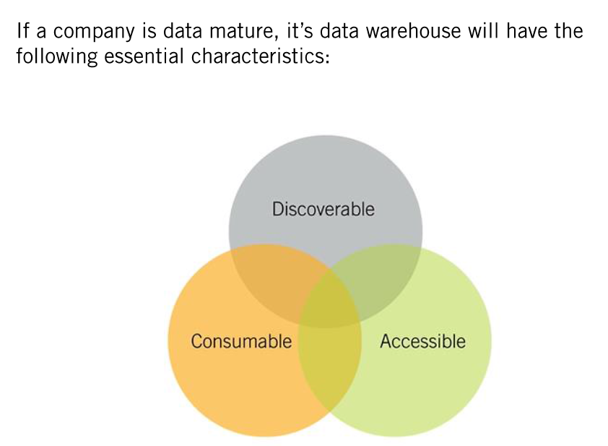
Artificial Intelligence – Building Capabilities: Data and Data Science Team

Slide 14
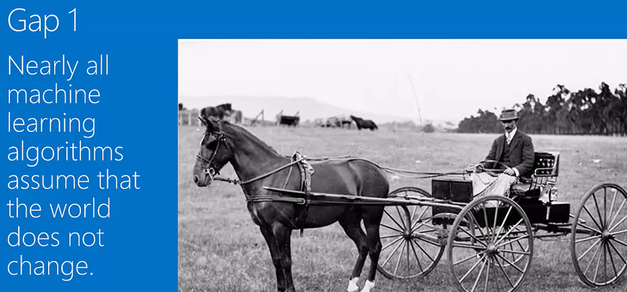

Slide 15
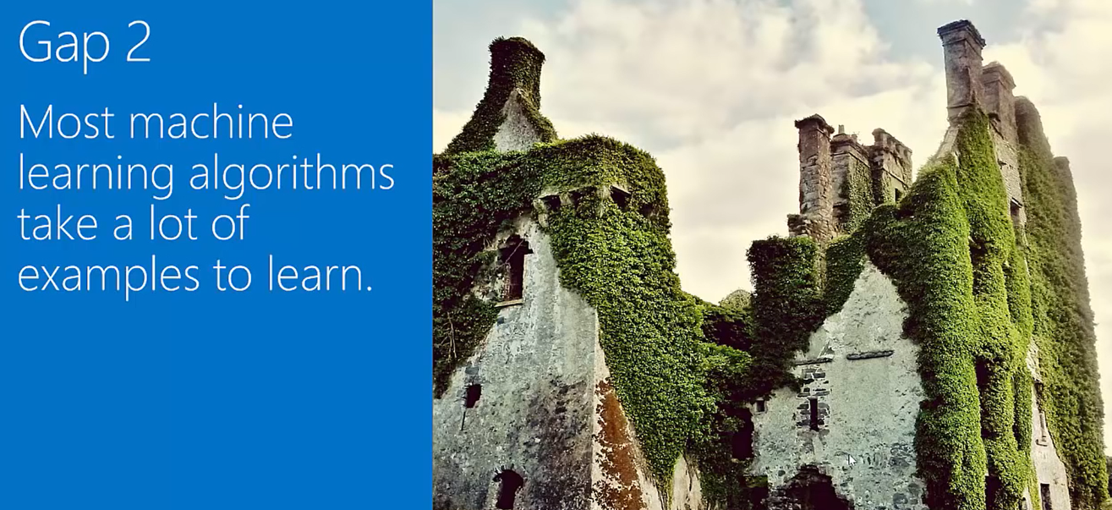

Slide 16
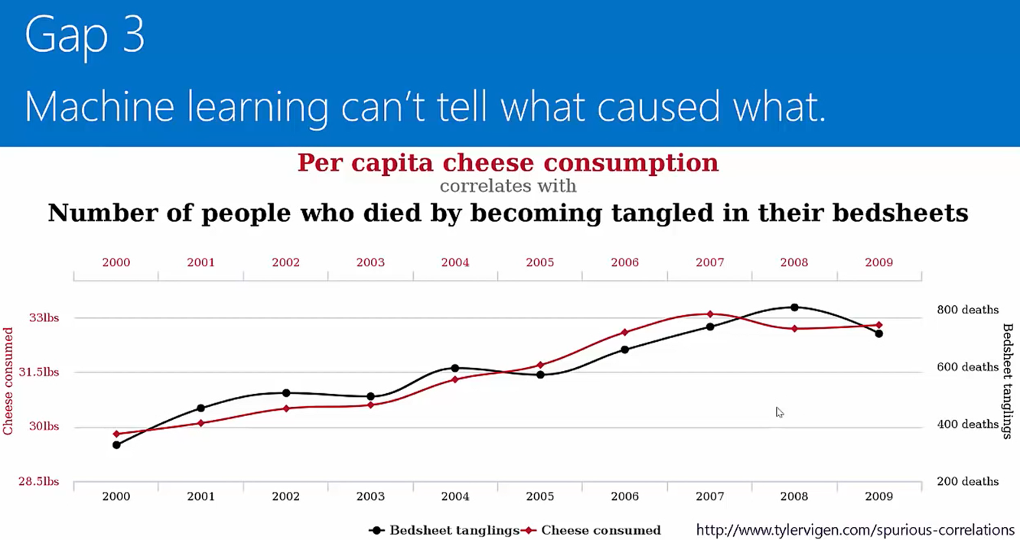

Slide 17


Slide 18
Data driven decision making

Slide 19
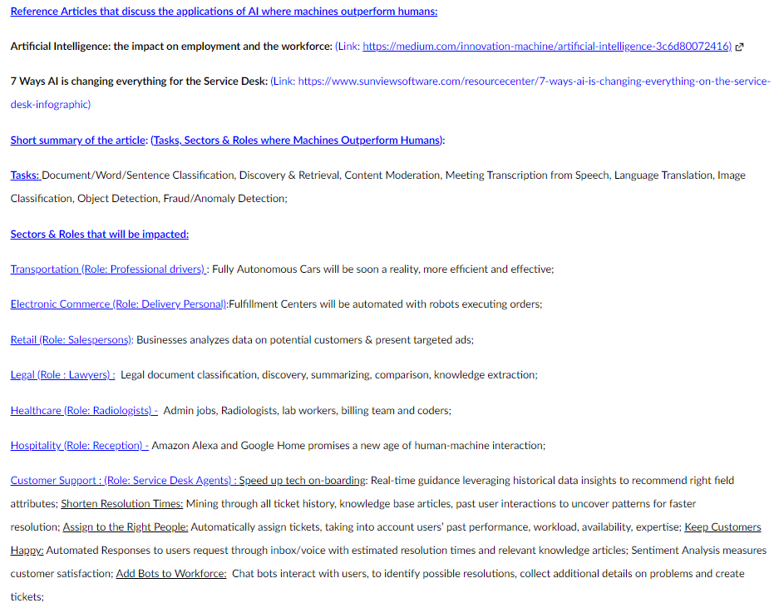
AI Displacing Humans in the Workforce
Applications of AI where Machines outperform or are expected to outperform Humans

Slide 20
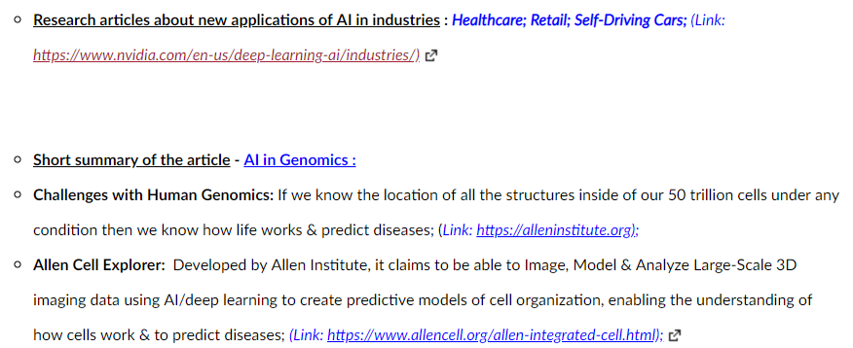
Industries Being Newly Affected by AI
New Applications of AI in industries that have traditionally not been sources for AI adoption

Slide 21
Data Acquisition and Preparation

Slide 22
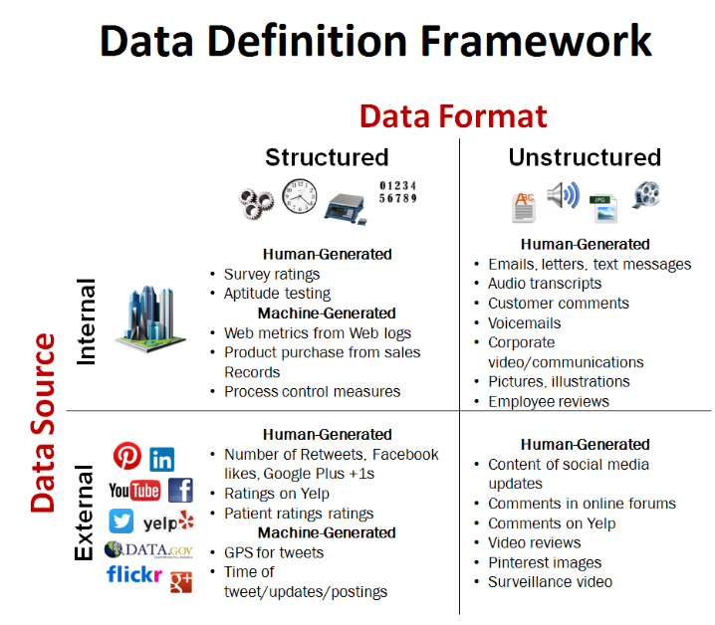
Data Format

Slide 23
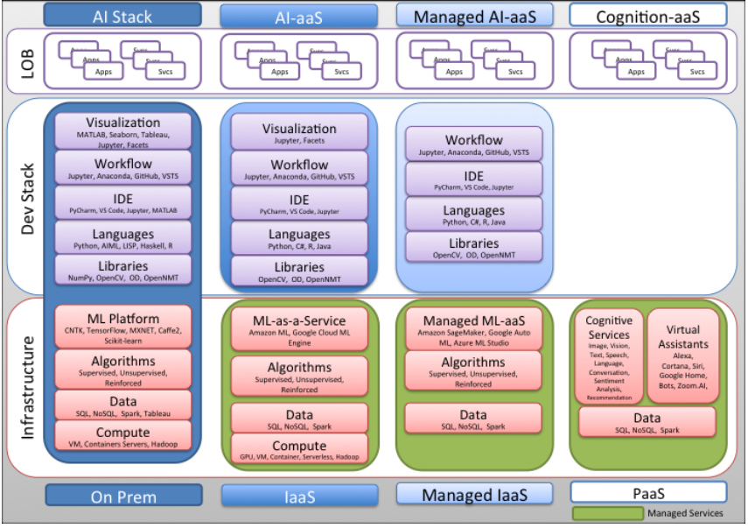
Cloud - AI & ML Stack

Slide 24
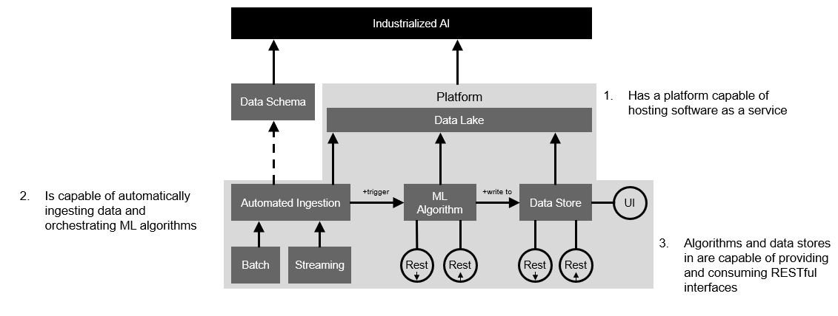
Consumption Models Modern AI Stack

Slide 25

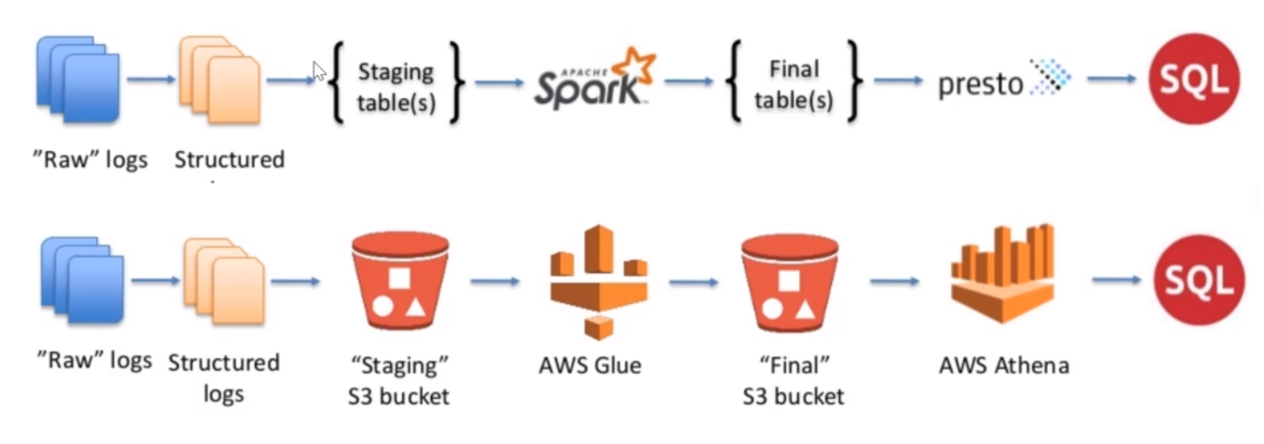
Automation of Log Analysis Pipeline (On Prem Vs AWS Cloud Native Services)
Data Providers
API Call
S3

Slide 26
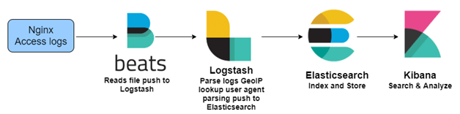
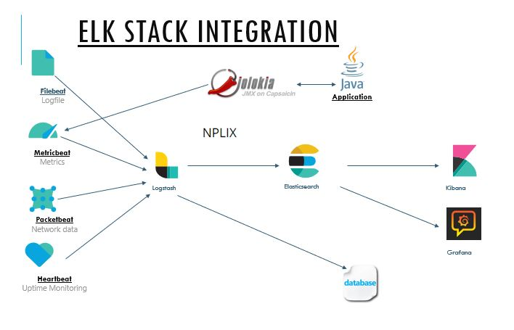
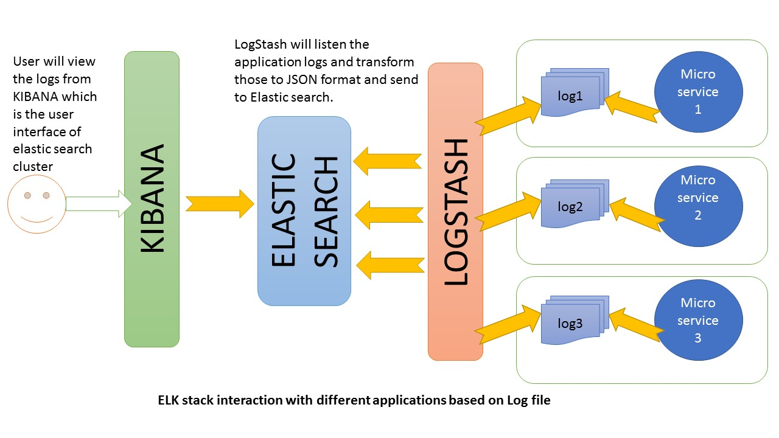
Log Analysis Pipeline using the ELK Stack

Slide 27
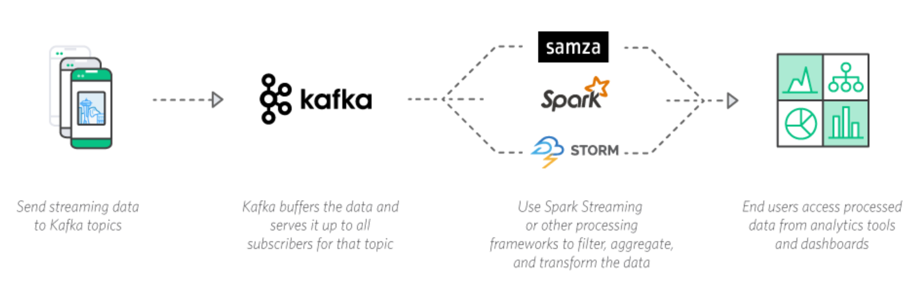
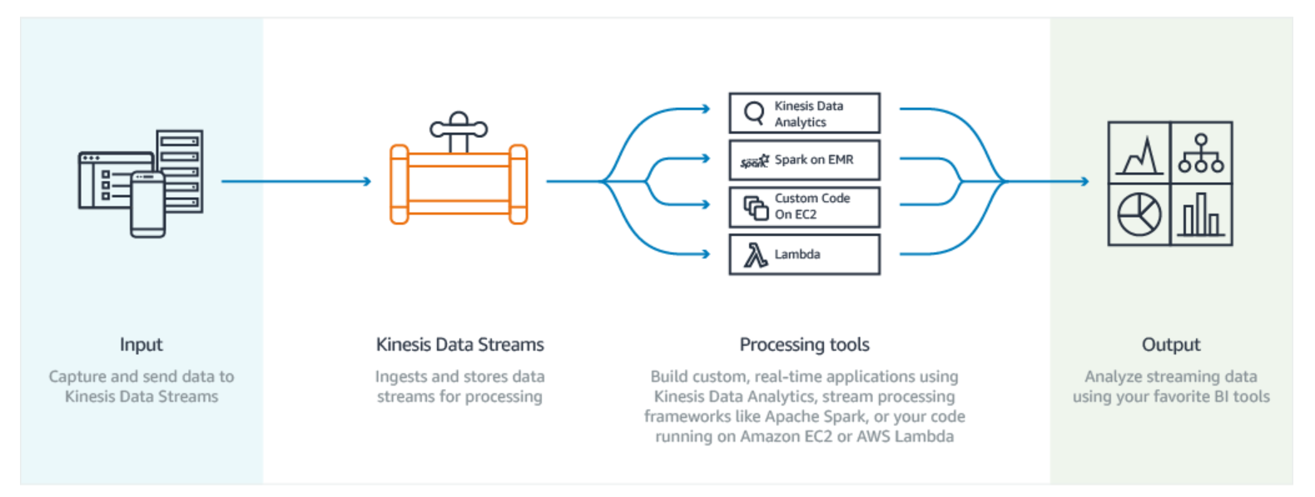
Automation of Event Stream Analysis Pipeline (On Prem Vs AWS Cloud Native Services)
Global Account
Data Providers
API Call
Notes:
Apache Kafka is an open source, distributed messaging system that enables you to build real-time applications using streaming data. You can send streaming data such as website clickstreams, financial transactions, and application logs to your Kafka cluster, and it buffers the data and serves it to stream processing applications built on frameworks including Apache Spark Streaming, Apache Storm, or Apache Samza.

Slide 28





Automation of Batch Process Analytics Pipeline (AWS Cloud Native Services)
ML FACTORY
(Step Function)
SageMaker
DATA PROCESSING
TRAININGS
DEPLOYMENTS

Slide 29











Automated Data Ingestion (Azure Cloud Native Services)
Data Sources
Ingest, Integrate & Transform
Store
Govern
Analyze
Consume
DB
Documents
Stream
Azure Data Factory
Azure SQL DWH
(Structured Data)
Data Catalog (Metadata Mgmt.)
Azure ML Studio
(Data Science)
Power BI
(Report / Dashboard)
Events
Cloud
Azure DataBricks (Process)
Azure Blob (Staging / Unstructured Data)
Azure HDInsight
(Process)
Azure Search
Azure Event Hub
(Real Time)
SQL Server
(Structured Data)
Cognitive Services
(AI APIs)
DB
On-Prem
Documents
Events
Azure Stream Analytics
Azure Data Lake
(Distributed File Sys)

Slide 30
Data Formats

Slide 31
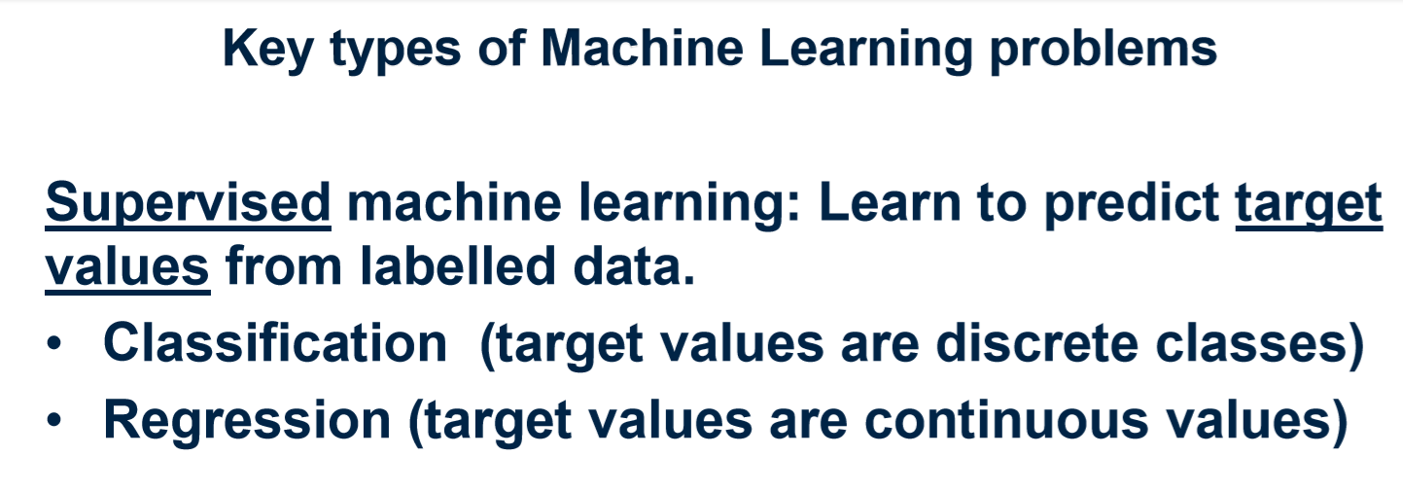

Slide 32
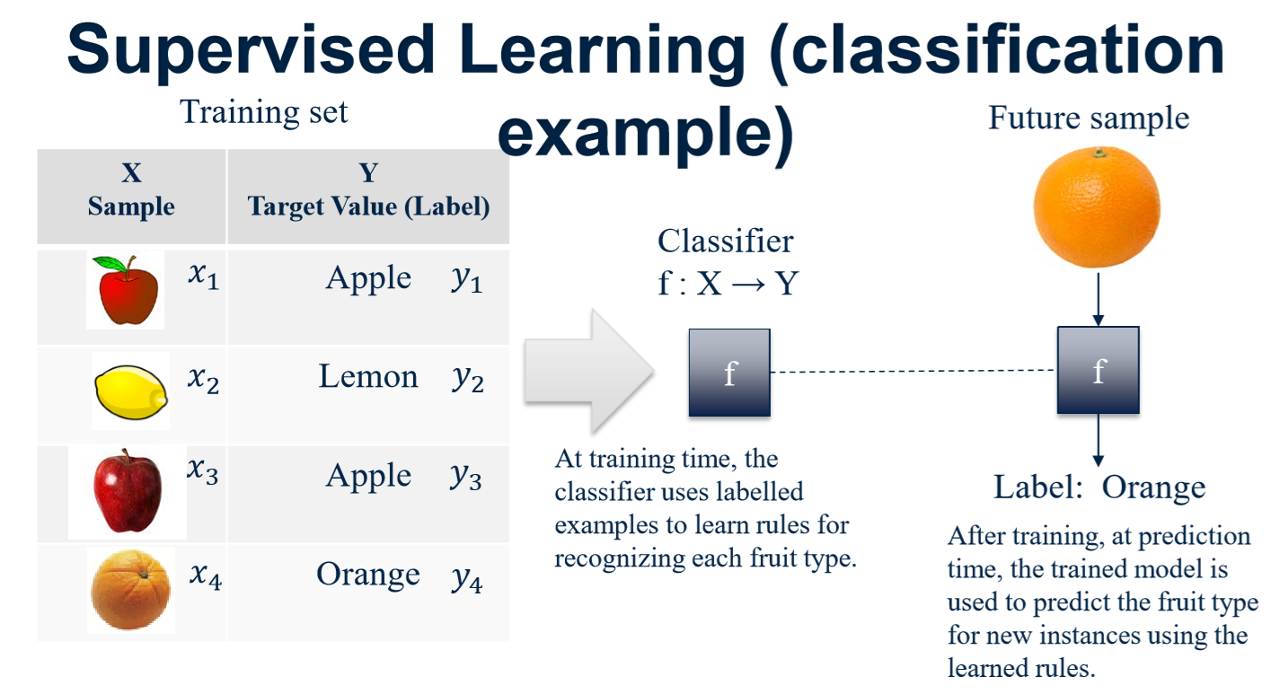

Slide 33
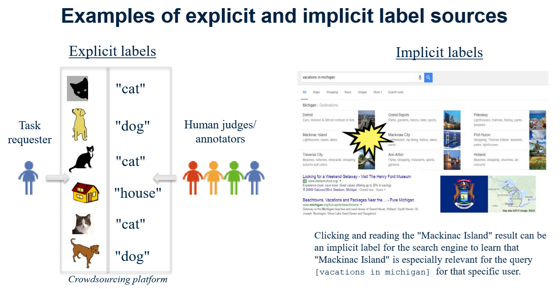

Slide 34
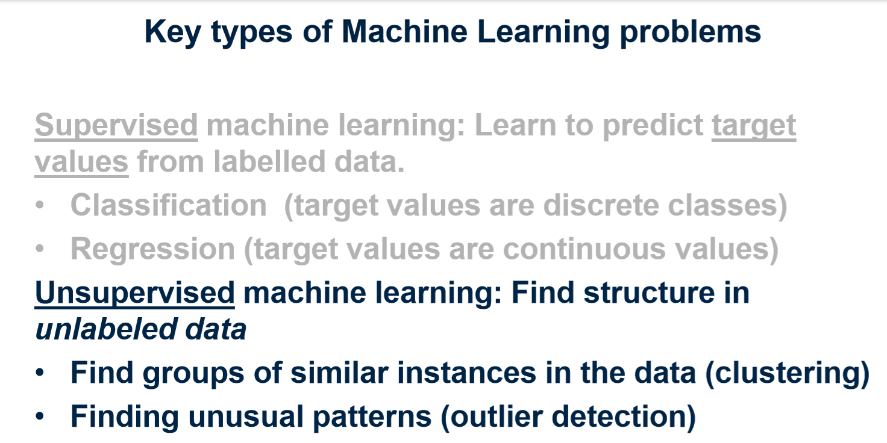

Slide 35
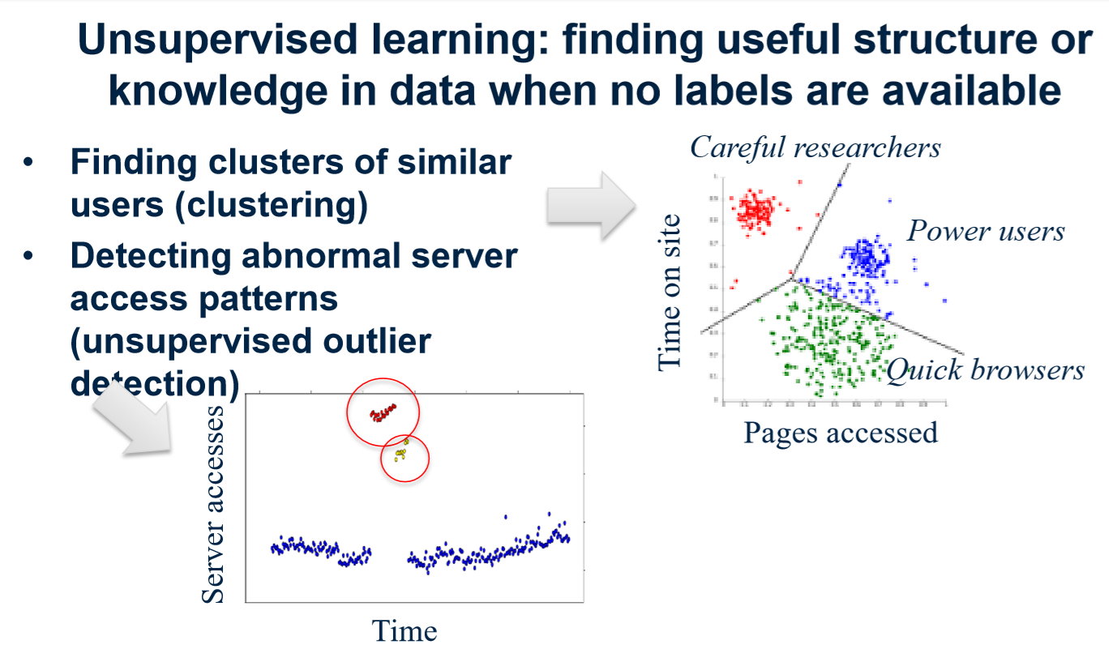

Slide 36
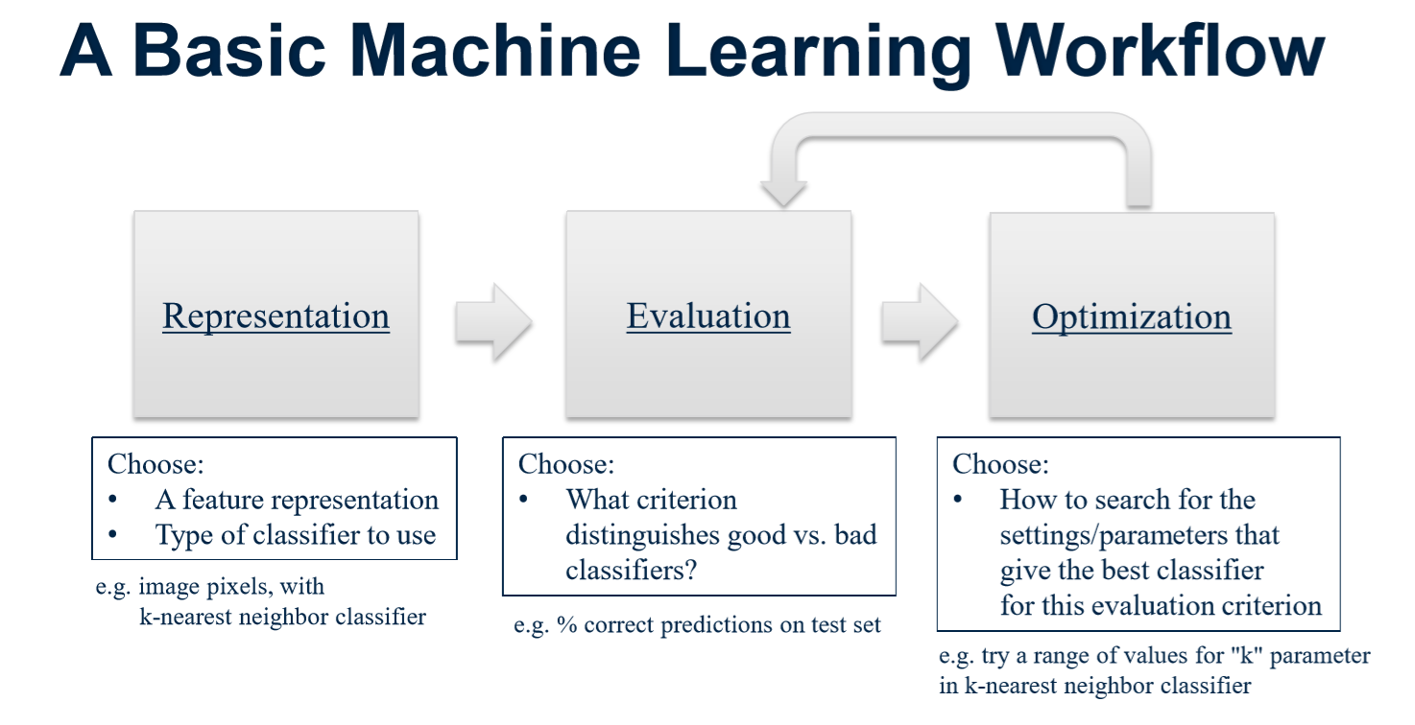

Slide 37
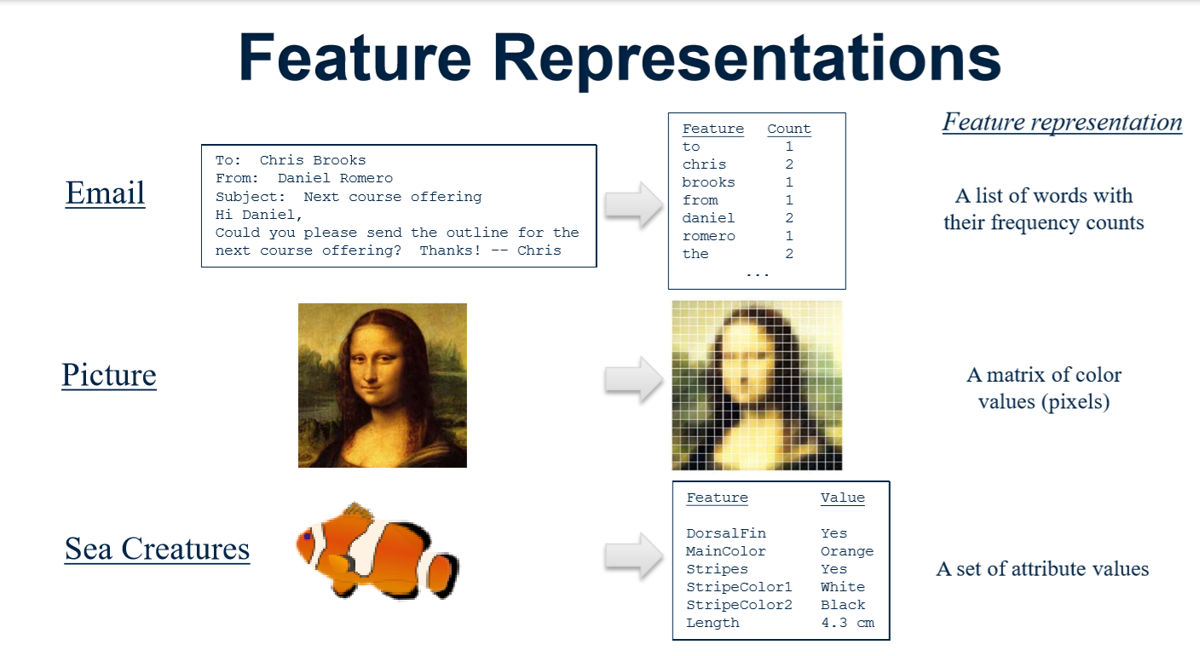

Slide 38
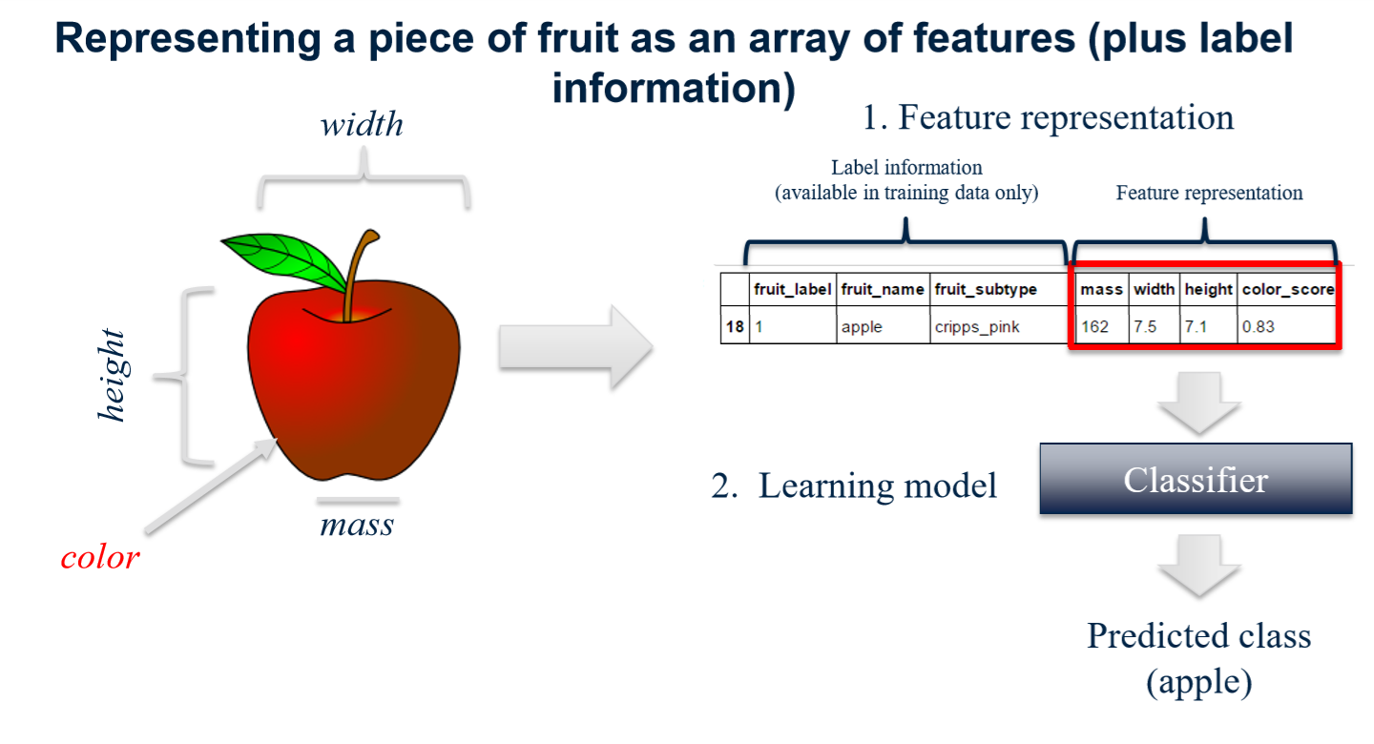

Slide 39
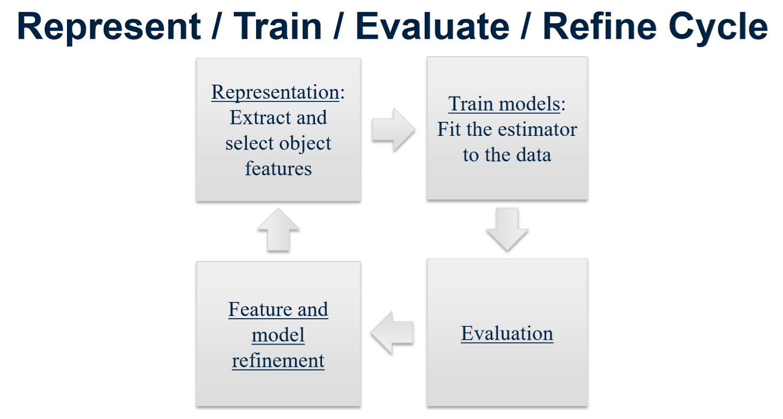

Slide 40
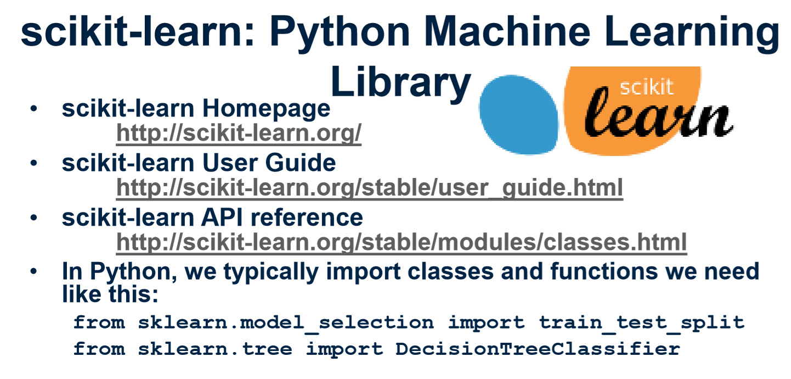

Slide 41
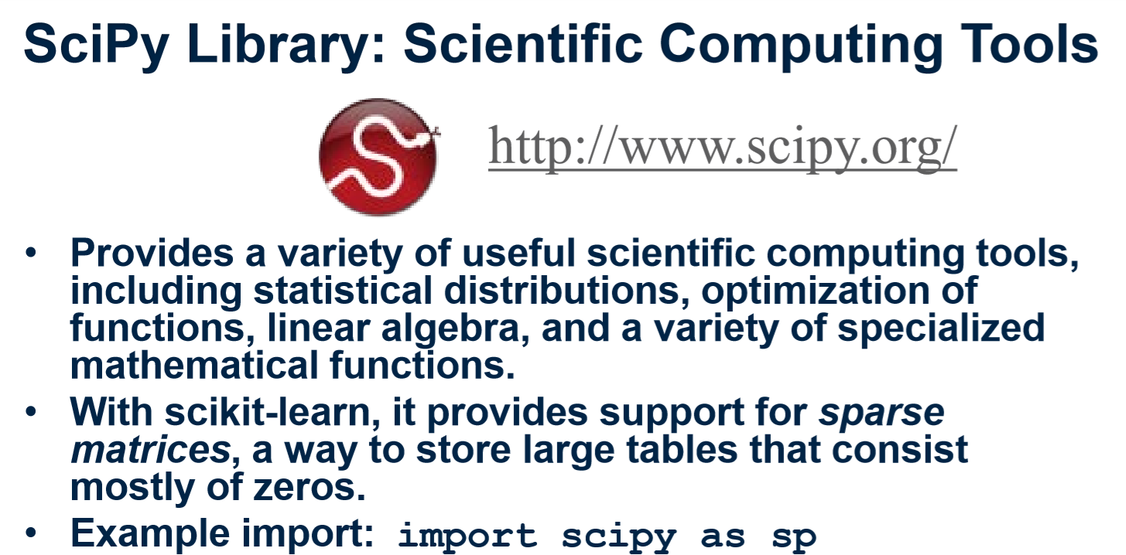

Slide 42
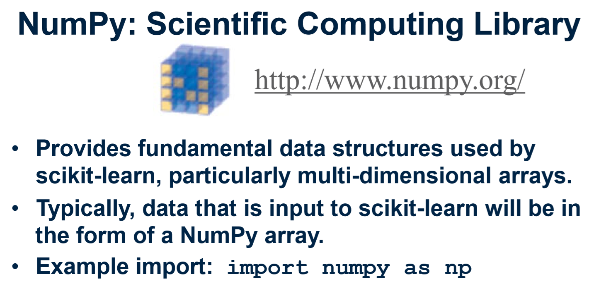

Slide 43
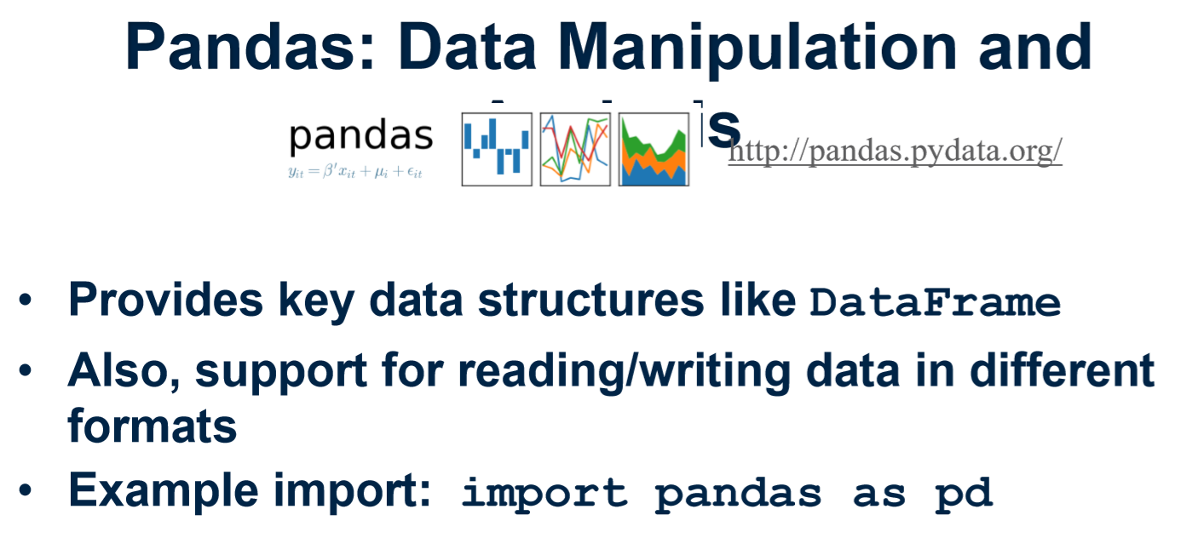

Slide 44
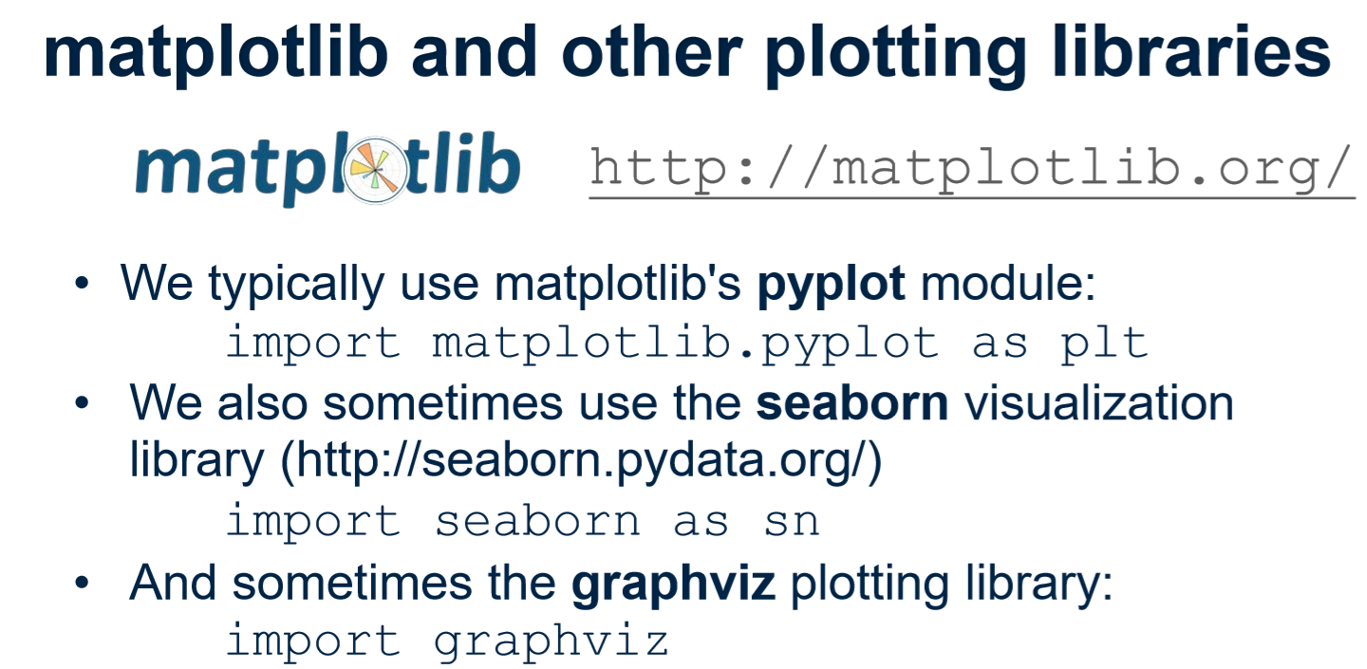

Slide 46
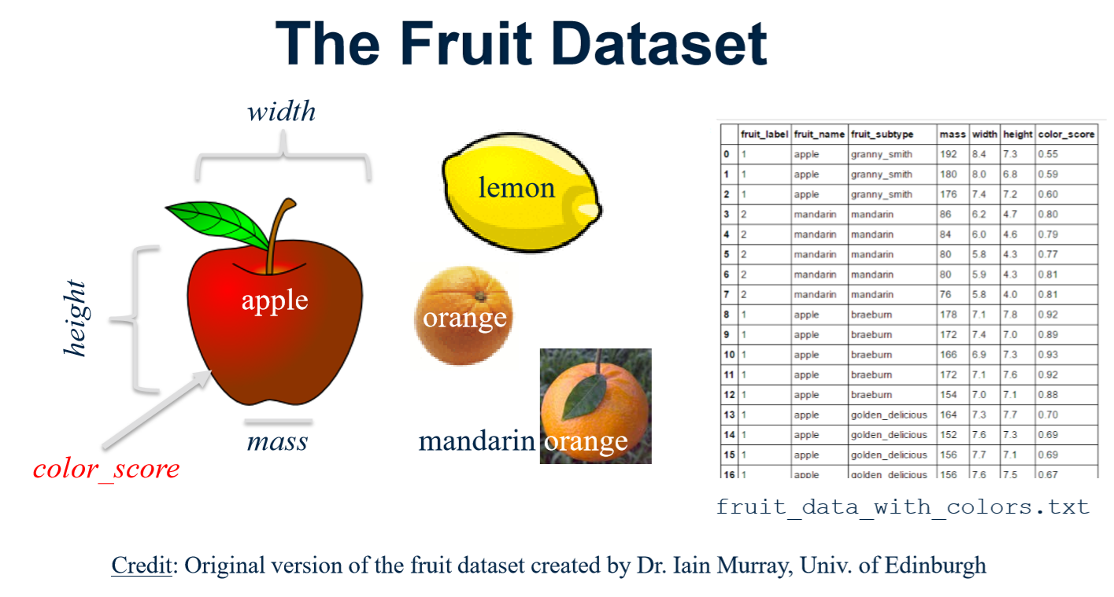

Slide 47
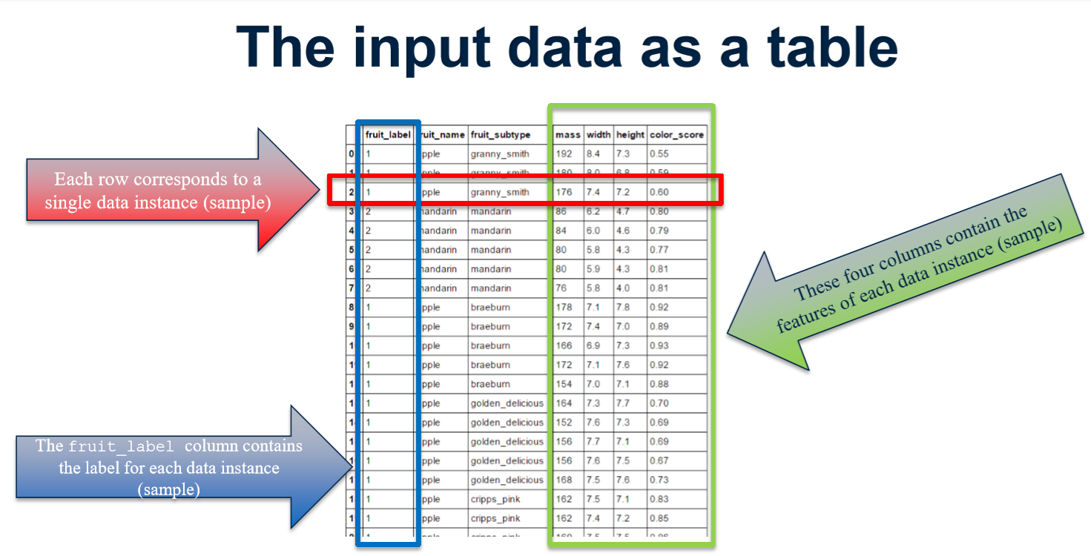

Slide 48
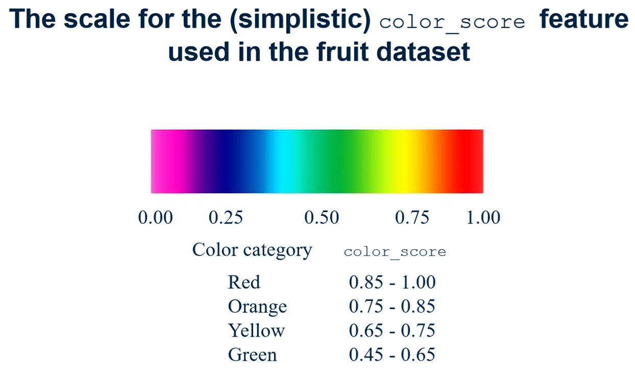

Slide 49
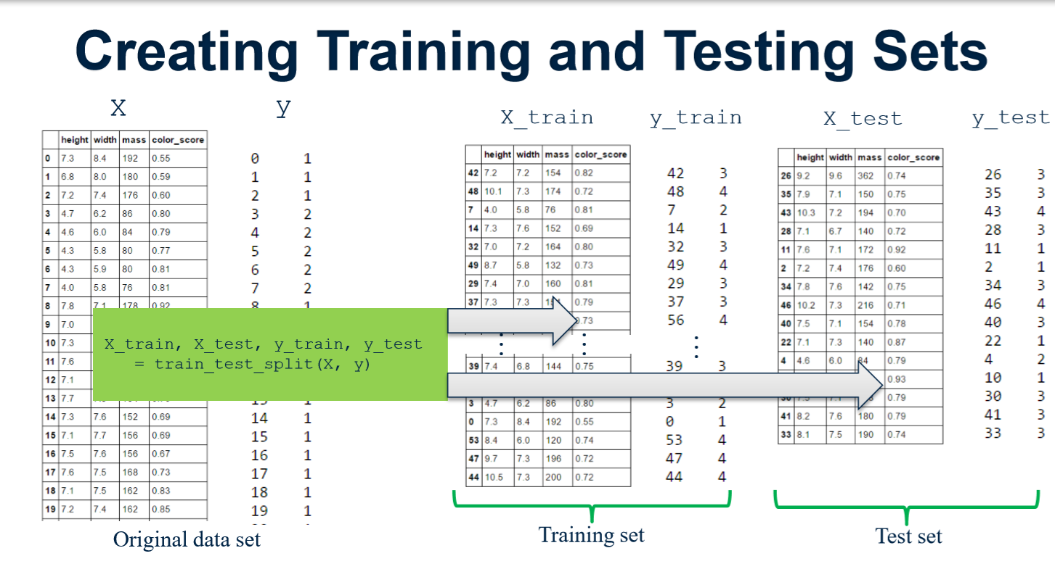

Slide 50


Slide 51
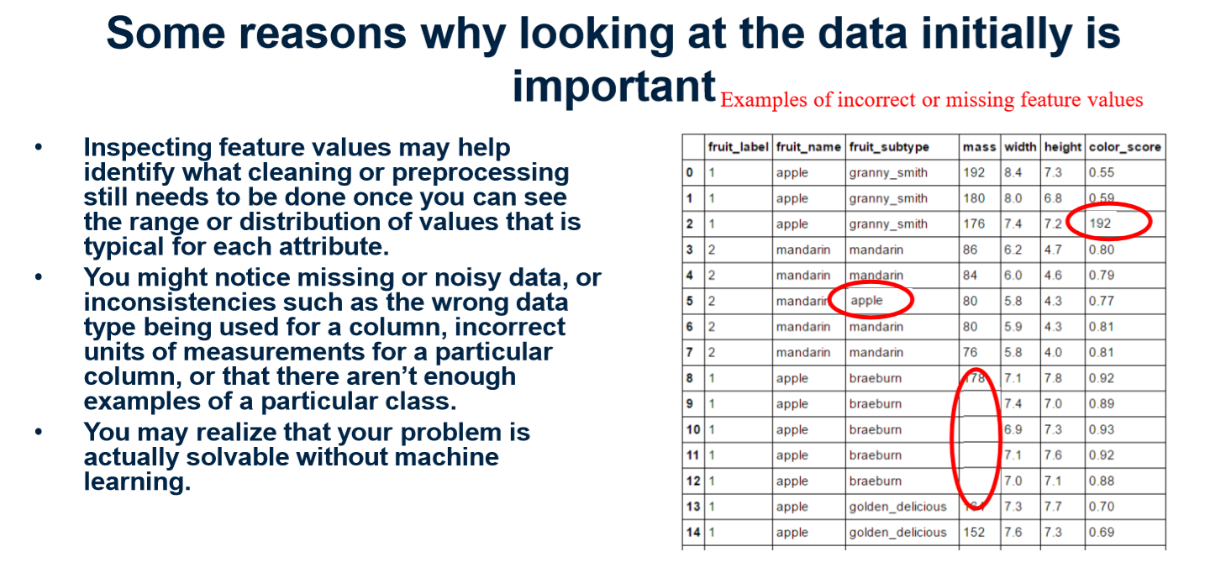

Slide 52
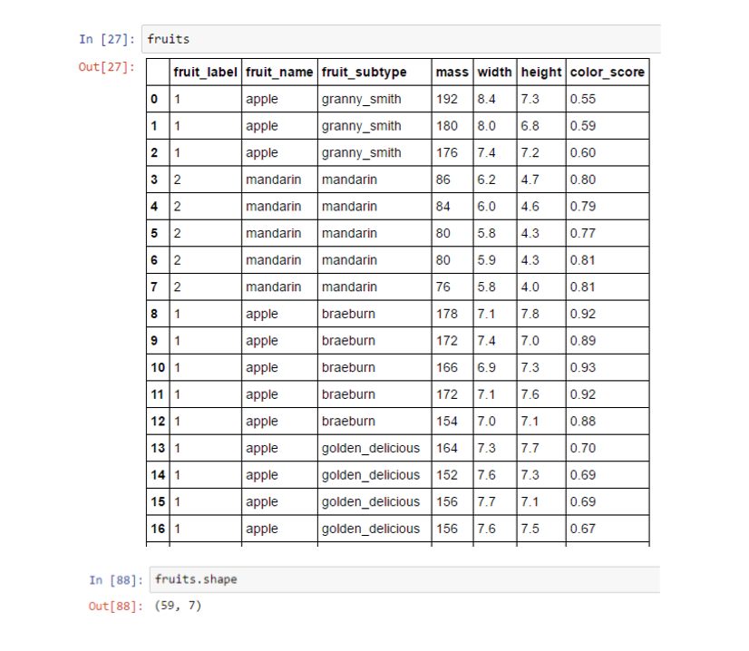

Slide 53
